Slide 1
High Performance Kafka Streaming
A code demo of developing a microservice using Apache Kafka hosted on Aiven Cloud

Slide 2
Agenda
Solution Architecture
Assumptions
Design Choices
Code Demo

Slide 3
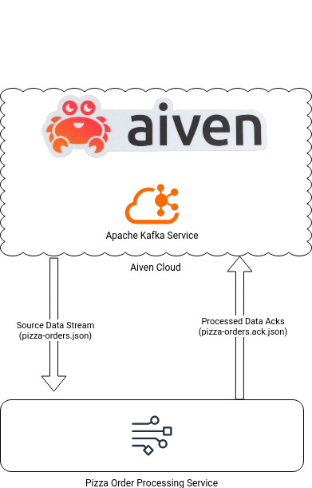
Solution Architecture

Slide 4
Assumptions
You have basic understanding of Apache Kafka. E.g., Topic, Partition, Key, Value

Slide 5
Design Choices
Developed using Scala
In Functional Programming Dialect
https://www.scala-lang.org/
Using Cats Effect as Async Runtime
Based on light weight Fibers over the System Level Threads
https://typelevel.org/cats-effect/
Uses Functional Streams for Scala (fs2)
https://fs2.io/
Seamlessly integrates horizontal scaling provided by Kafka
Provides effortless vertical scaling by using Cats Effect Runtime Fibers
Frees the developers from managing multi-threaded code

Slide 6
Code Demo

Slide 7
Thank you
Rehan Mahmood

Slide 8
Effective delivery techniques
This is a powerful tool in public speaking. It involves varying pitch, tone, and volume to convey emotion, emphasize points, and maintain interest:
Pitch variation
Tone inflection
Volume control
Effective body language enhances your message, making it more impactful and memorable:
Meaningful eye contact
Purposeful gestures
Maintain good posture
Control your expressions

Slide 9
Navigating Q&A sessions
Know your material in advance
Anticipate common questions
Rehearse your responses
Maintaining composure during the Q&A session is essential for projecting confidence and authority. Consider the following tips for staying composed:
Stay calm
Actively listen
Pause and reflect
Maintain eye contact

Slide 10

Speaking impact
Your ability to communicate effectively will leave a lasting impact on your audience
Effectively communicating involves not only delivering a message but also resonating with the experiences, values, and emotions of those listening

Slide 11
Dynamic delivery
Learn to infuse energy into your delivery to leave a lasting impression.
One of the goals of effective communication is to motivate your audience.
Metric | Measurement | Target | Actual
Audience attendance | # of attendees | 150 | 120
Engagement duration | Minutes | 60 | 75
Q&A interaction | # of questions | 10 | 15
Positive feedback | Percentage (%) | 90 | 95
Rate of information retention | Percentage (%) | 80 | 85

Slide 12
Speaking engagement metrics
Impact factor | Measurement | Target | Achieved
Audience interaction | Percentage (%) | 85 | 88
Knowledge retention | Percentage (%) | 75 | 80
Post-presentation surveys | Average rating | 4.2 | 4.5
Referral rate | Percentage (%) | 10 | 12
Collaboration opportunities | # of opportunities | 8 | 10

